Slide 1
BASIC PYTHON – DATA – MANIPULATION - OBJECTIVE

Slide 2
INTRODUCTION
Python is a high-level programming language known for its simplicity and readability.
It features dynamic typing, making it flexible for various tasks.
Basic Python syntax includes indentation for code blocks and the use of colons to denote the beginning of control flow statements like loops and conditionals.
Variables are dynamically typed, eliminating the need for explicit declarations. Python supports various data types like integers, floats, strings, lists, tuples, and dictionaries. Functions are defined using the 'def' keyword, and modules can be imported to extend functionality.
Python's extensive standard library offers modules for diverse purposes, making it suitable for beginners and experienced programmers alike.

Slide 3
String Indexing: ---Sting indexing, also known as "sting," is a technique used in information retrieval systems to efficiently locate and retrieve relevant data from large volumes of text or documents. ---It involves three main steps: sifting, thresholding, and indexing .---First, irrelevant data is filtered out through sifting, then remaining terms are scored based on relevance in thresholding, and finally, indexed for efficient retrieval. ---This method balances precision and recall, improving the speed and accuracy of information retrieval systems.

Slide 4
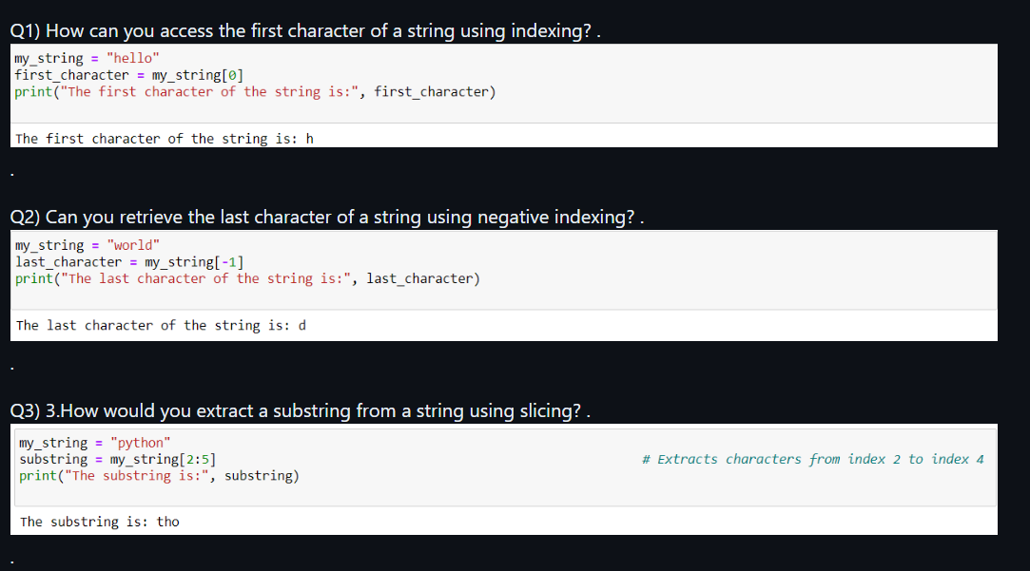

Slide 5
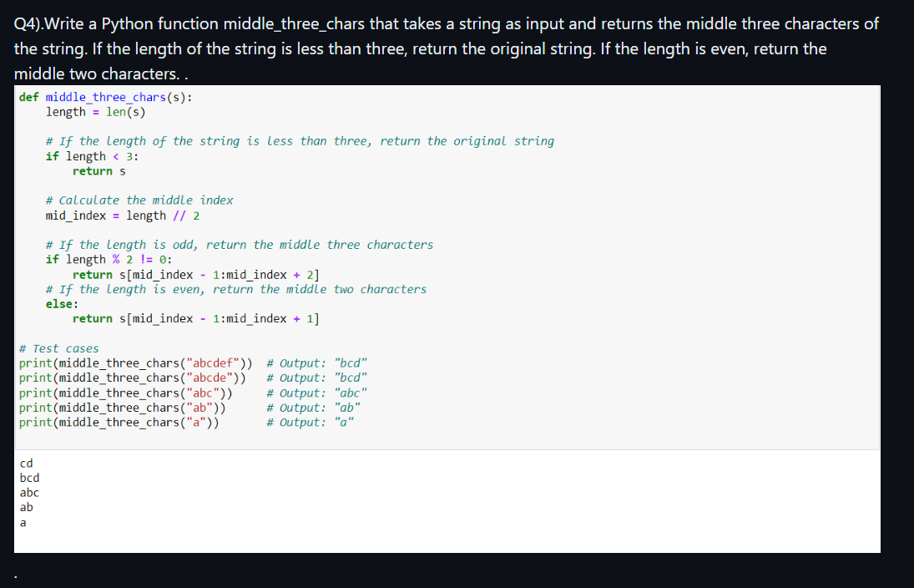

Slide 6
List Operations: ---List operations are essential in programming for manipulating collections of data. ---They include actions like adding, removing, and accessing elements within a list. ---These operations provide flexibility in managing lists, making them fundamental in various programming tasks.

Slide 7
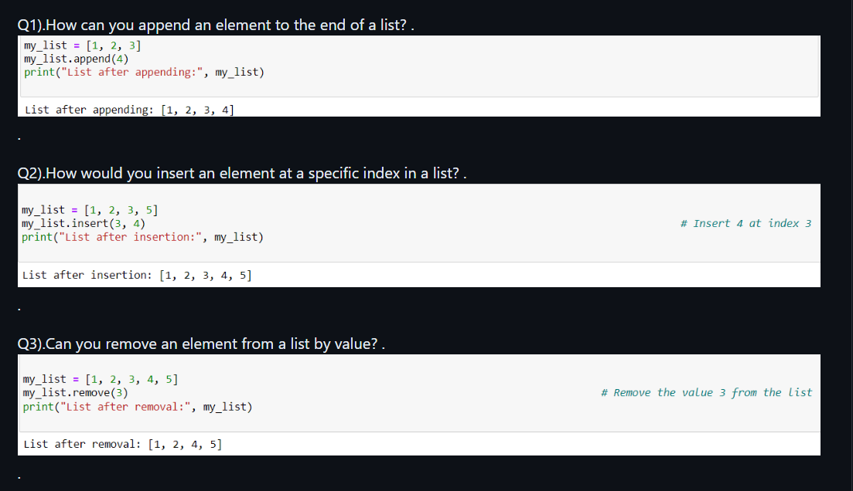

Slide 8
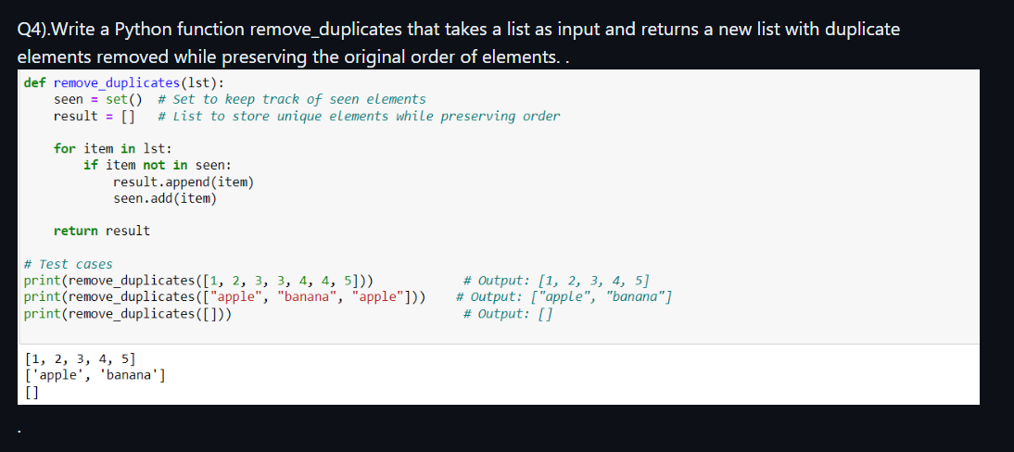

Slide 9
Dictionary Operations: ---Dictionary operations are essential in programming for managing key-value pairs. ---They include insertion, access, update, deletion, existence check, and retrieval of keys, values, and items. ---These operations facilitate efficient storage and manipulation of data, making dictionaries a fundamental tool in programming for tasks like data organization, caching, and more.

Slide 10
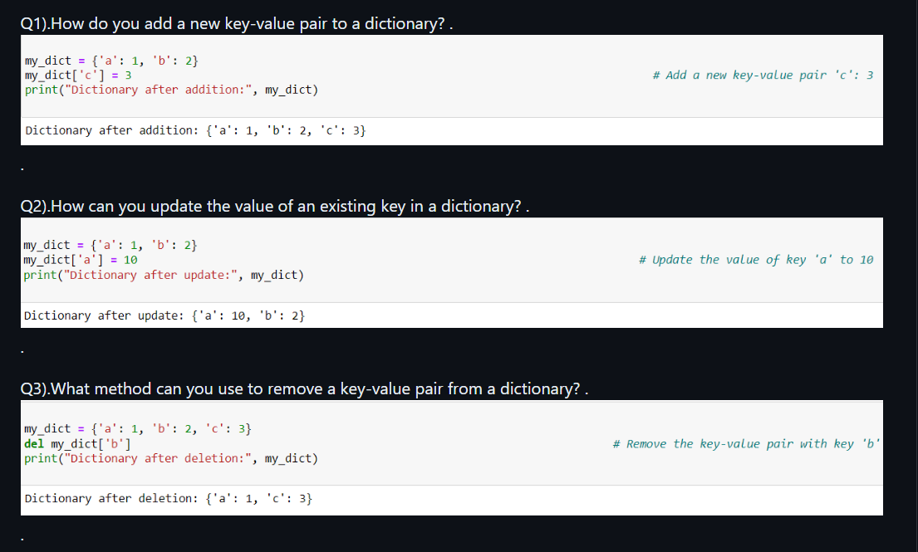

Slide 11
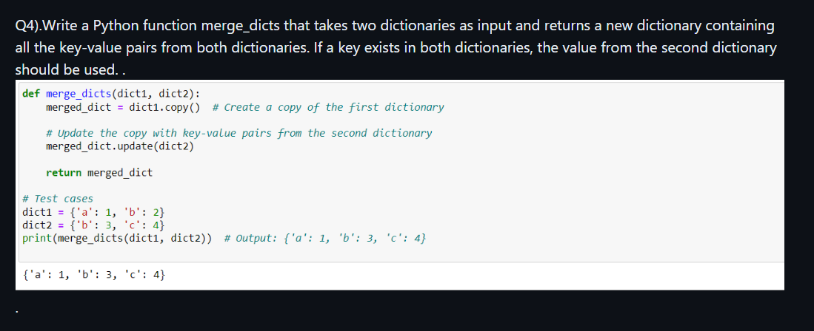

Slide 12
len() Function: ---The len() function in Python is a built-in function used to determine the length or size of an object. ---It's primarily used with data structures like strings, lists, tuples, dictionaries, and sets to find the number of elements contained within them.

Slide 13
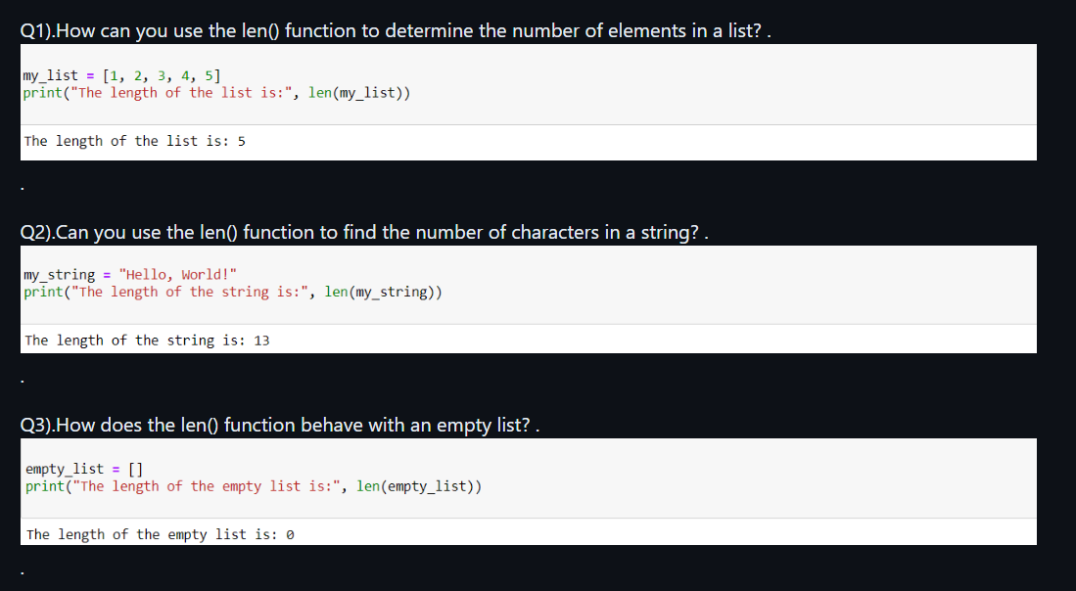

Slide 14
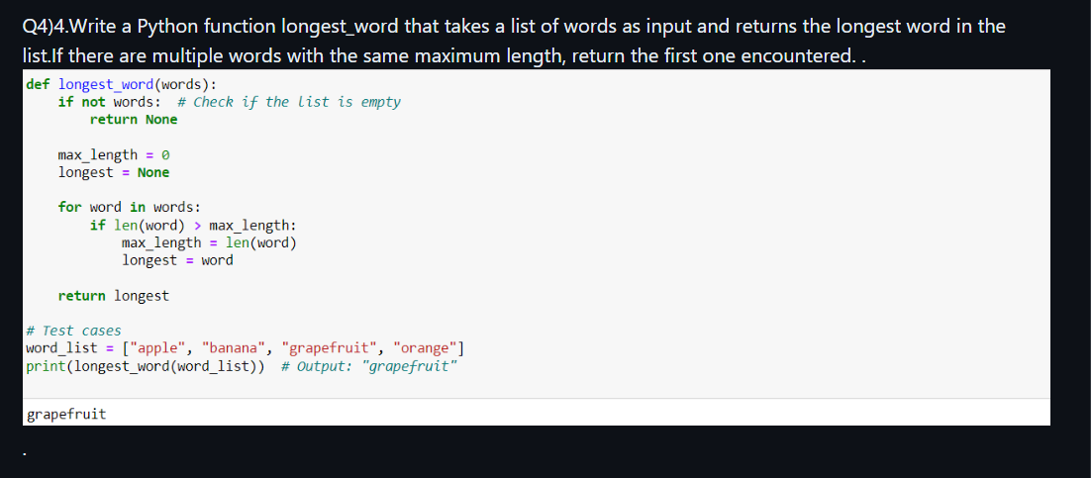

Slide 15
sum() Function: ---The sum() function in Python calculates the total sum of numeric elements in an iterable, like lists or tuples, with an optional starting value. ---It's succinctly expressed as sum(iterable, start=0), where iterable contains numeric values to be summed, and start is an optional value added to the sum. ---This function is handy for aggregating numerical data and computing totals efficiently in various programming tasks.

Slide 16
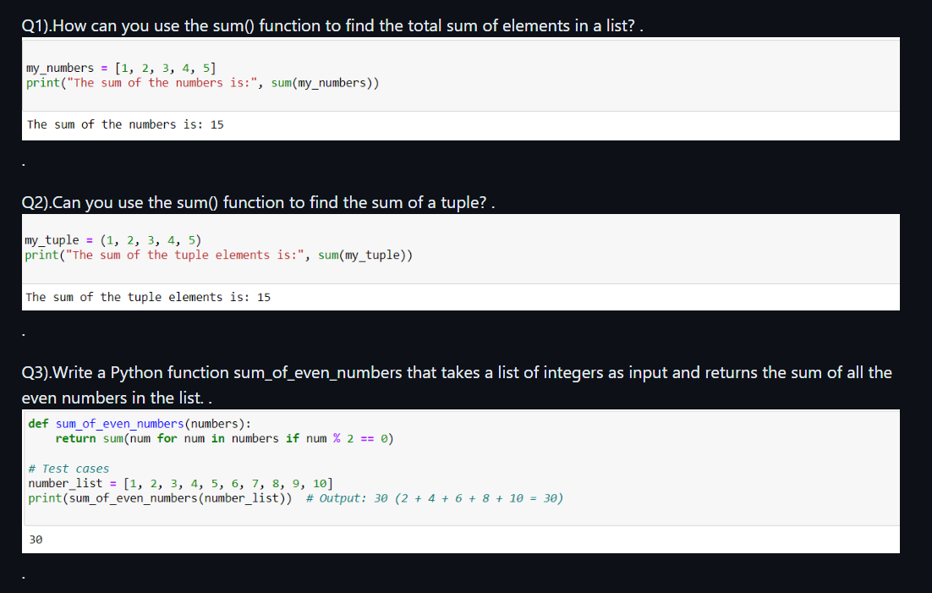

Slide 17
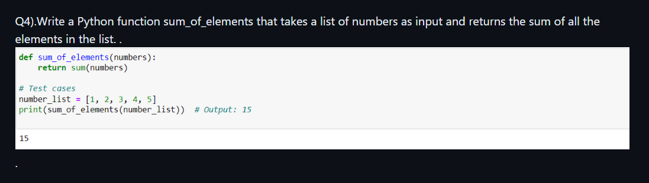

Slide 18
max() Function: .---The max() function in Python returns the maximum value from a sequence or collection. ---Its syntax, max(iterable, *iterables, key=default, default=object), allows comparison of multiple sequences with optional key functions . ---Parameters include the iterable(s) to analyze, a comparison key, and a default value if the sequence is empty. ---For example, max([3, 7, 2, 5]) returns 7. It's essential for quickly identifying the highest value in data sets, aiding in tasks like finding the largest number in a list or selecting the latest timestamp in a dataset.

Slide 19
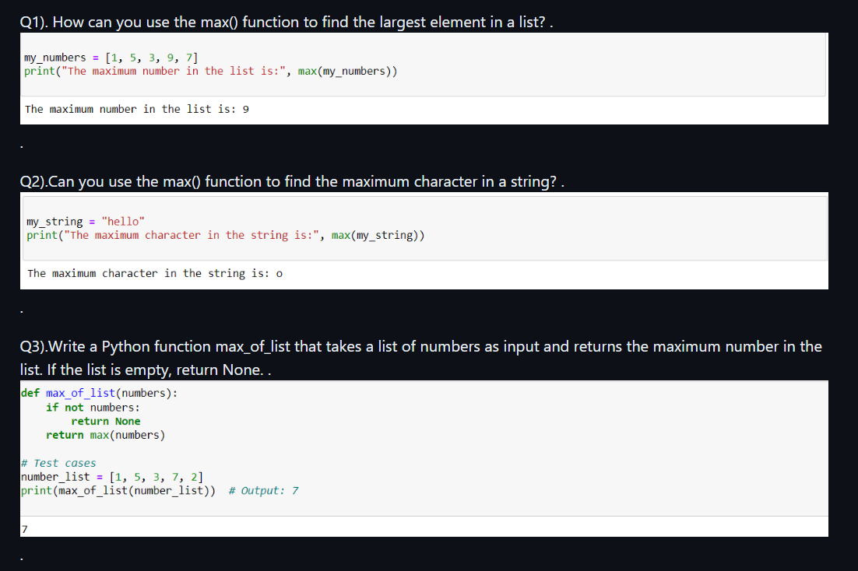

Slide 20
min() Function:. ---The min() function in Python returns the minimum value from a sequence or collection. ---Its syntax, min(iterable, *iterables, key=default, default=object), allows comparison of multiple sequences with optional key functions. ---Parameters include the iterable(s) to analyze, a comparison key, and a default value if the sequence is empty. For example, min([3, 7, 2, 5]) returns 2. ---It's crucial for quickly identifying the smallest value in data sets, aiding in tasks like finding the smallest number in a list or selecting the earliest timestamp in a dataset.

Slide 21
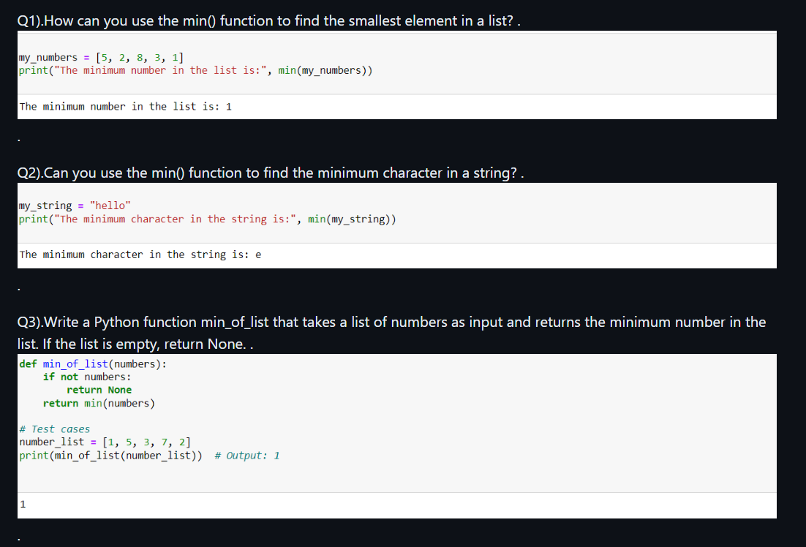

Slide 22
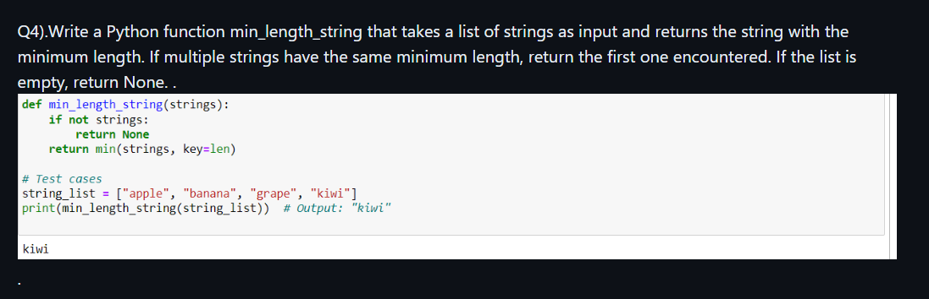

Slide 23
abs() Function: .---The abs() function in Python returns the absolute value of a number, disregarding its sign. ---Its syntax is abs(x), where x is the number whose absolute value is sought. For instance, abs(-5) returns 5. ---It's essential for tasks like distance calculation, error handling, and ensuring positive values in mathematical operations.

Slide 24
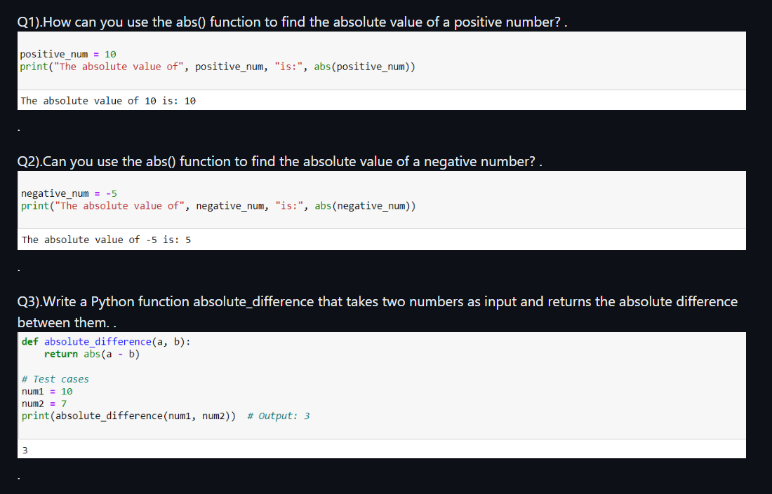

Slide 25
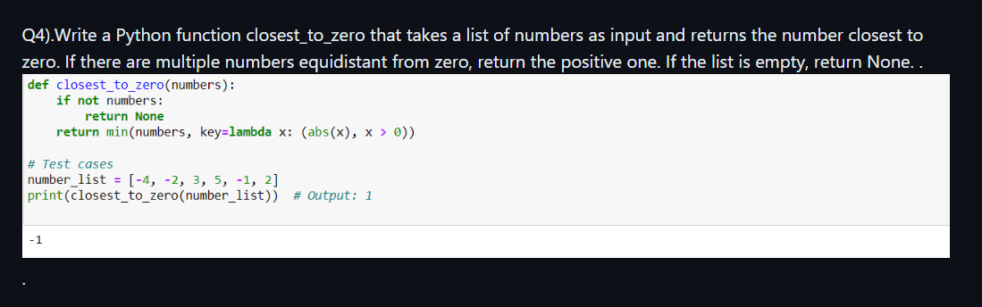

Slide 26
sorted() Function: .---The sorted() function in Python returns a sorted list from the elements of an iterable.---Its syntax is sorted(iterable, key=None, reverse=False). ---Parameters include the iterable to sort, an optional key function for custom sorting, and a flag for reverse sorting. ---For example, sorted([3, 1, 4, 2]) returns [1, 2, 3, 4]. ---It's valuable for arranging data in ascending or descending order, aiding in tasks like sorting lists, tuples, or dictionaries based on specific criteria.

Slide 27
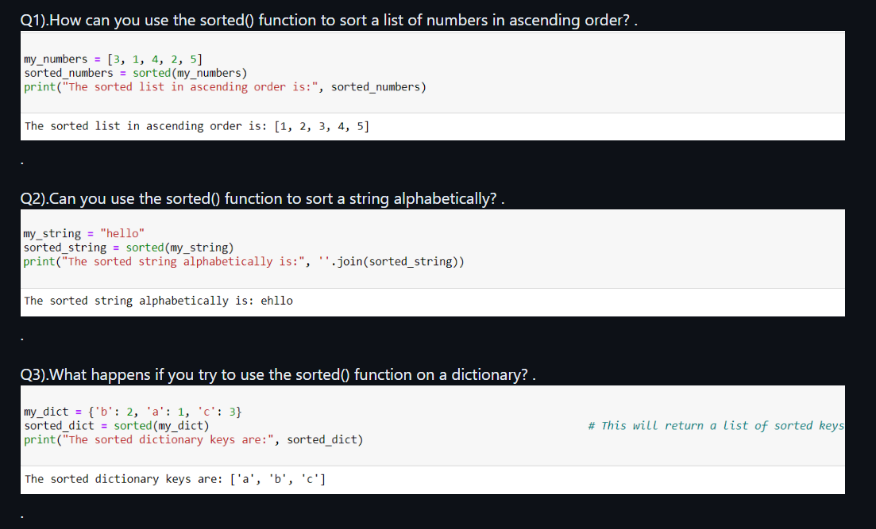

Slide 28
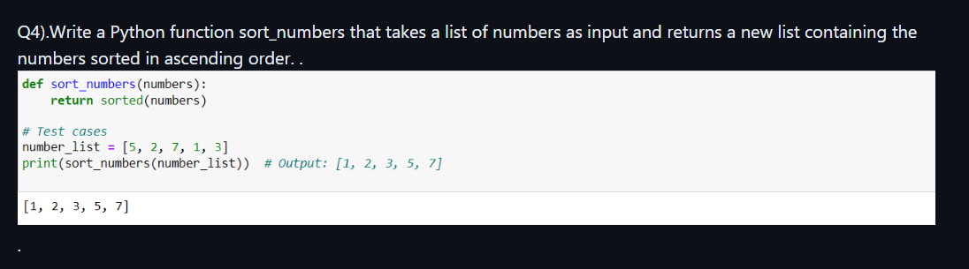

Slide 29
Class Creation:. ---Attributes define object properties, methods represent behaviors, and __init__() initializes attributes. ---Objects are created by calling the class name with parentheses. ---This process enables structured programming, code reusability, and encapsulation in Python

Slide 30
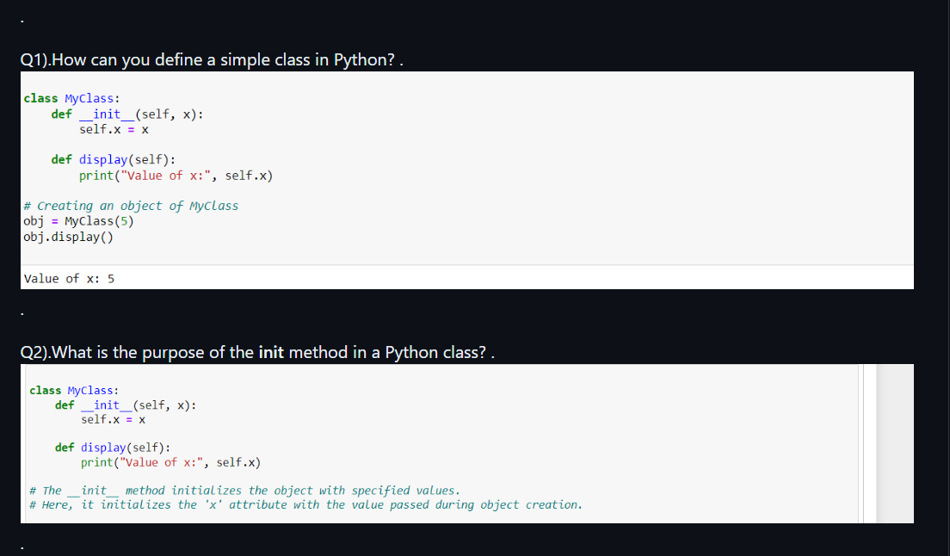

Slide 31
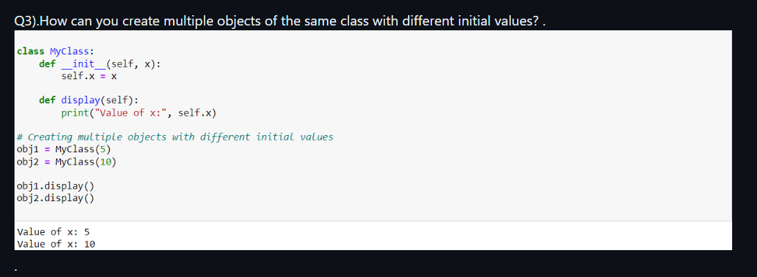
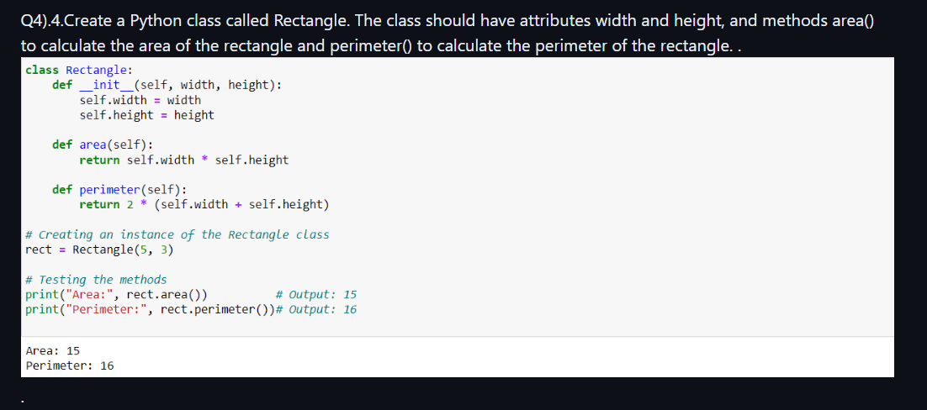

Slide 32
Class Inheritance:. ---The subclass inherits all superclass attributes and methods and can define its own .---This promotes code reuse, facilitates modular design, and encourages hierarchy-based organization in object-oriented programming. ---Subclasses can extend or override superclass behavior, enhancing flexibility and customization. Overall, inheritance fosters efficient and structured development by allowing classes to build upon existing functionalities while maintaining a clear and organized codebase

Slide 33
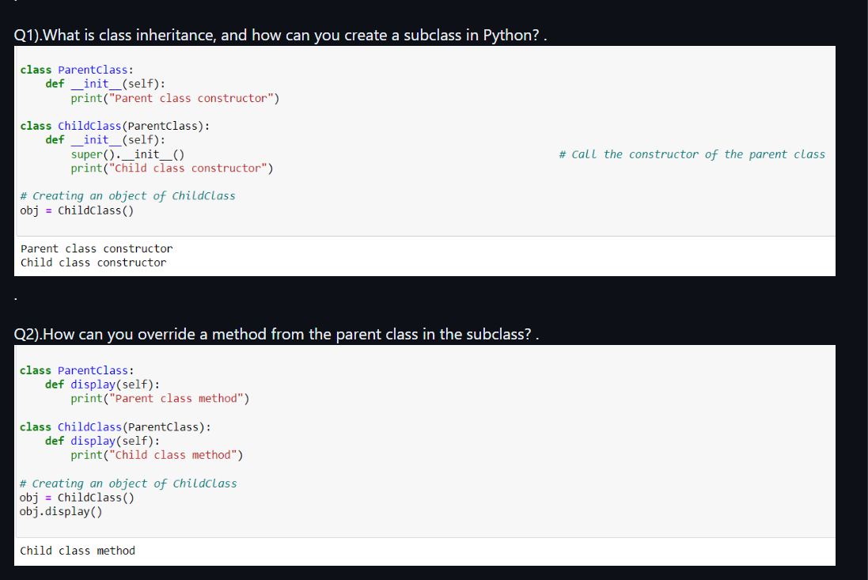

Slide 34
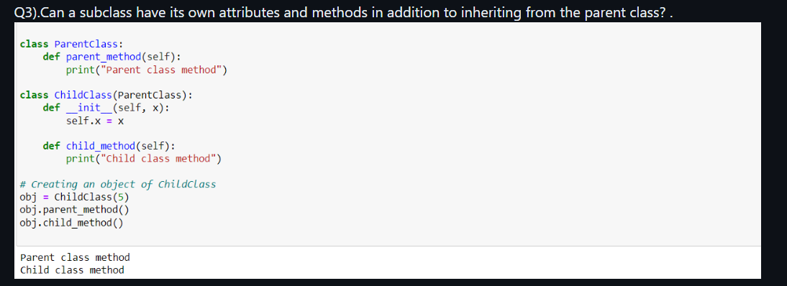
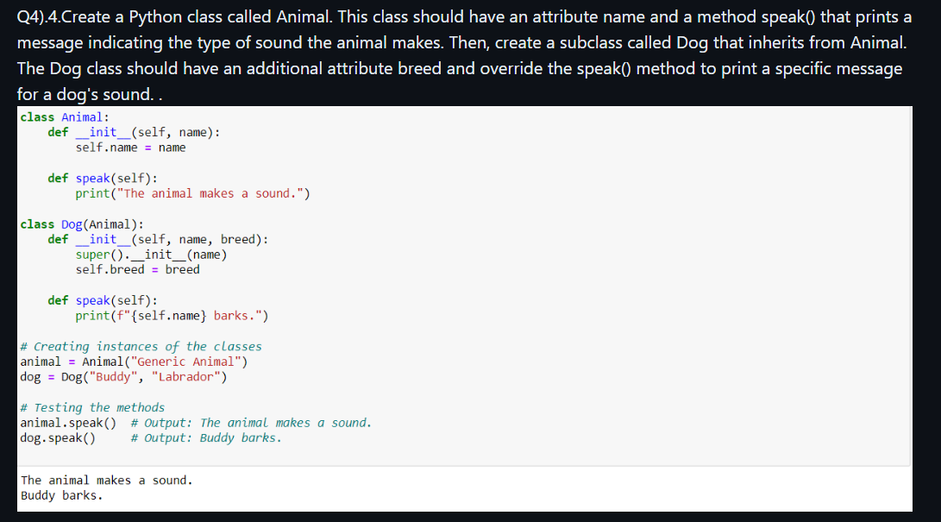

Slide 35
looping statements: .---Looping statements in programming, like "for" and "while" loops, repeatedly execute a block of code until a specified condition is met. ---Syntax varies but typically includes an iteration variable and a condition ---For loops iterate over each element in an iterable, while while loops continue executing as long as a condition is true. ---Looping statements are fundamental for automating repetitive tasks and iterating over data structures in programming..

Slide 36
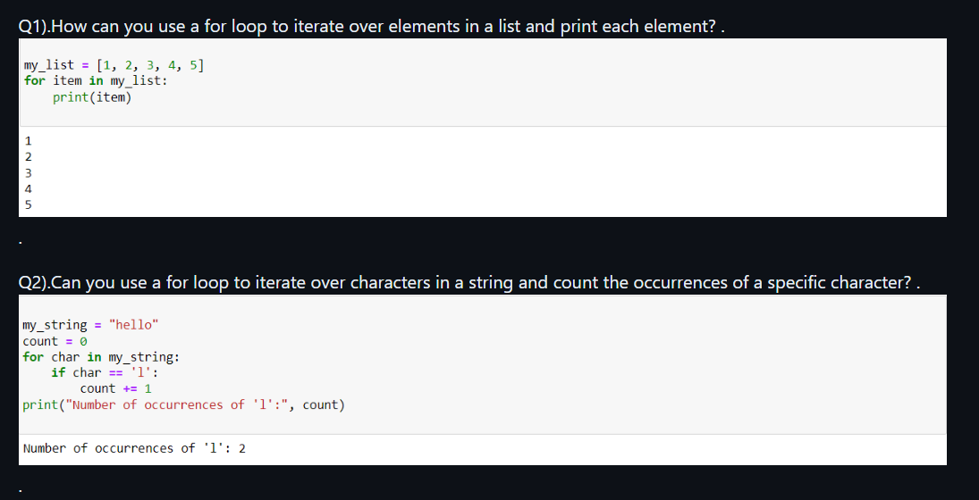
forloop

Slide 37
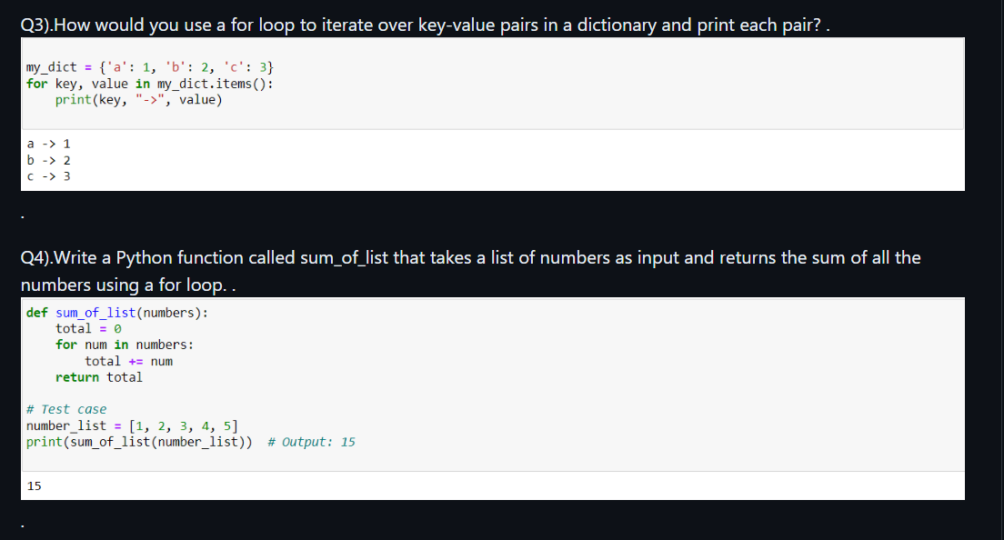

Slide 38
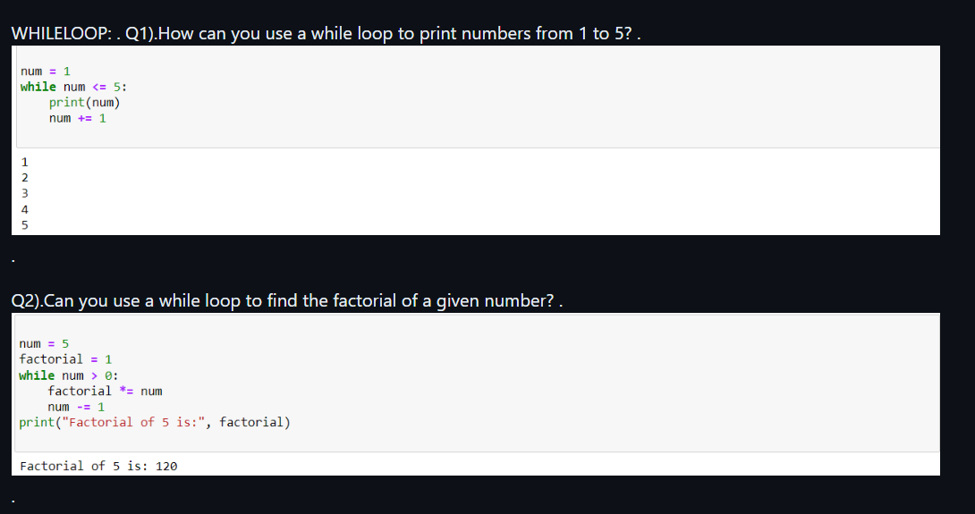
whileloop

Slide 39
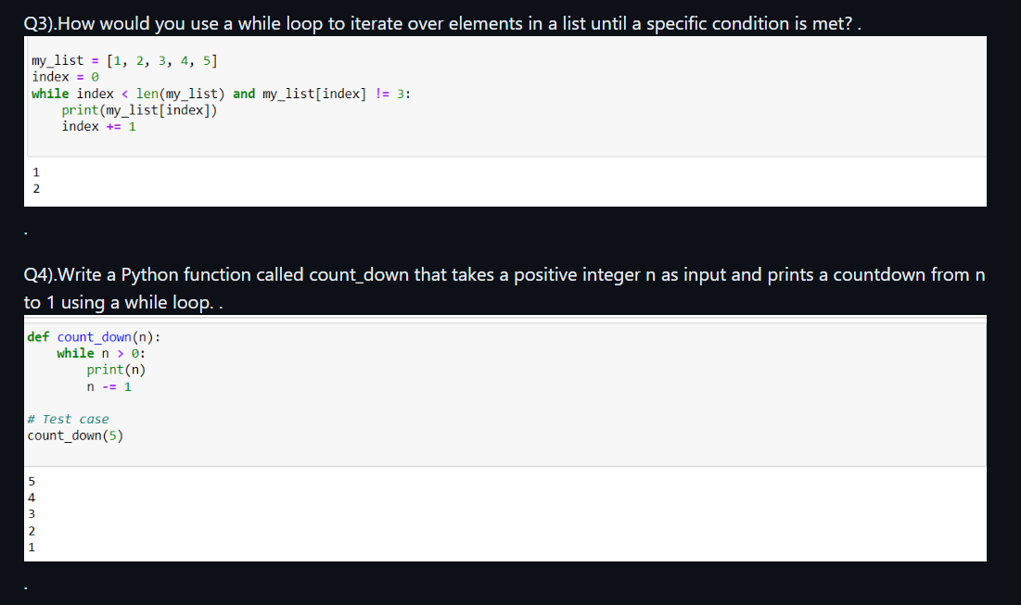

Slide 40
Lambda Function: .---A lambda function in Python is a small, anonymous function defined using the lambda keyword. ---Syntax: lambda arguments: expression. ---It's primarily used for one-line operations and is often passed as an argument to higher-order functions like map(), filter(), and sorted(). Example: double = lambda x: x * 2 .---Lambda functions are concise and handy for quick operations without the need for a formal function definition, enhancing code readability and reducing verbosity in certain contexts.

Slide 41
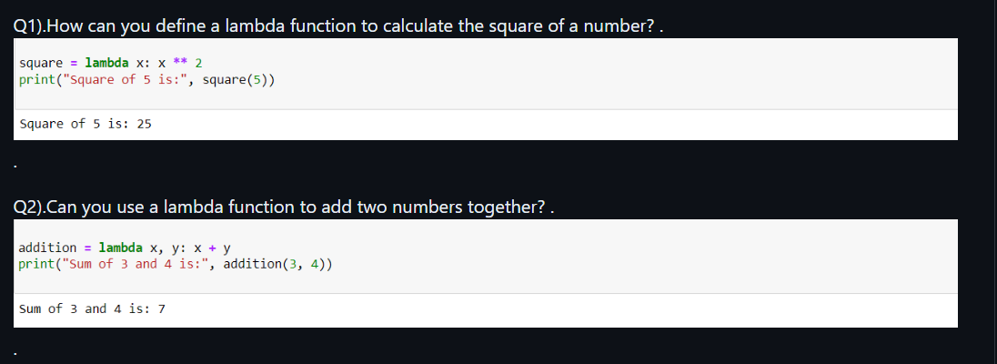

Slide 42
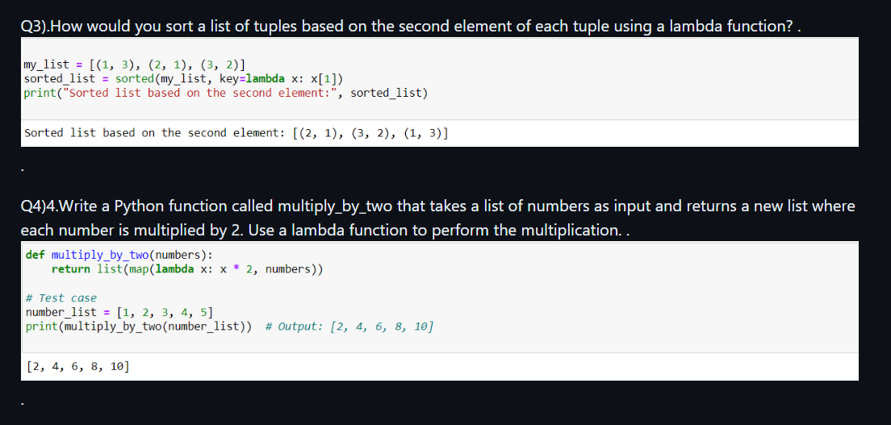

Slide 43
Pandas Module:. ---The Pandas module in Python provides powerful data manipulation and analysis tools, primarily through its DataFrame data structure. ---It offers functionality for handling structured data, including reading and writing various file formats, data cleaning, filtering, grouping, and statistical analysis. ---Syntax: import pandas as pd. ---Pandas is widely used in data science and analytics for tasks like data preprocessing, exploration, and visualization, making it an essential tool in the Python ecosystem for working with tabular data efficiently and effectively..

Slide 44
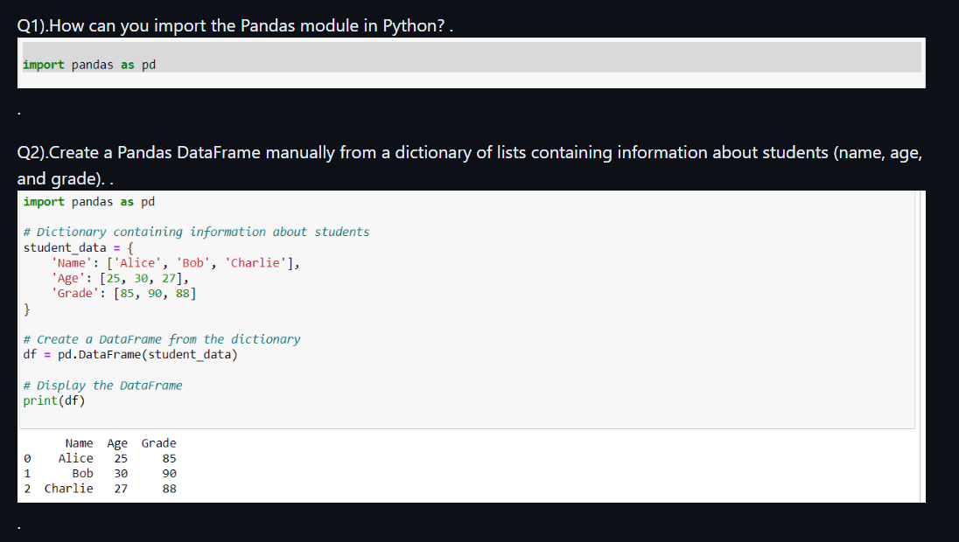
Data Loading and DataFrame Creation:

Slide 45
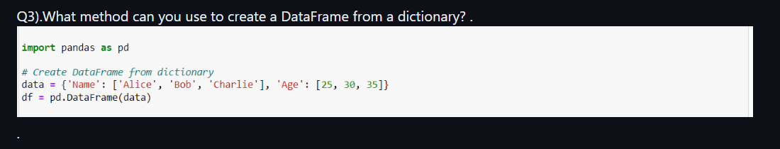

Slide 46
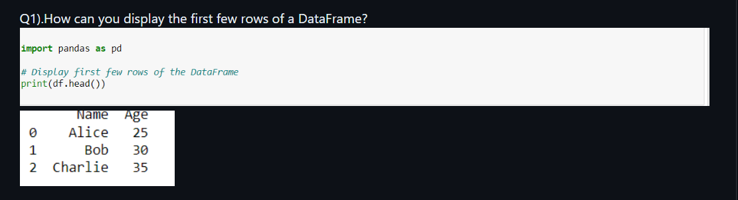
Data Exploration and Manipulation:

Slide 48
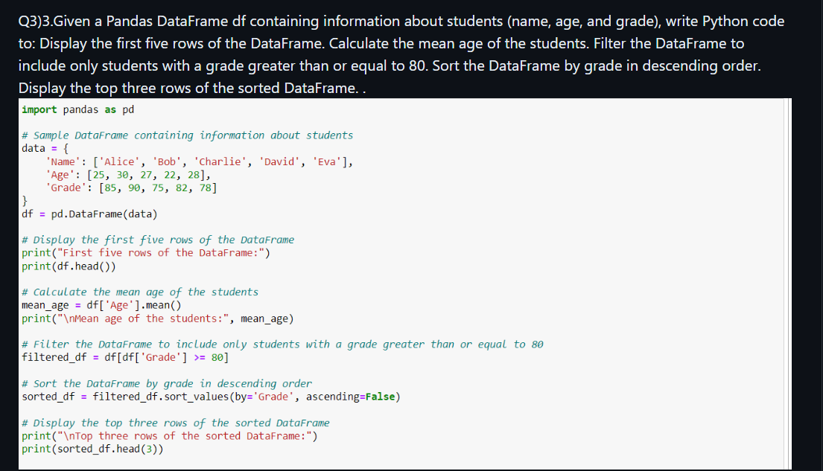
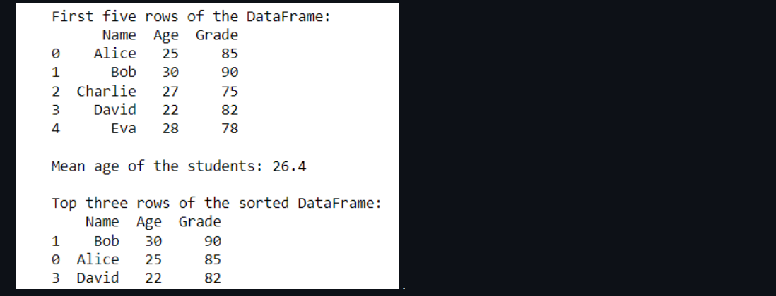

Slide 49
Thank you

